Slide 1
CRISP’s Progress in Supporting a Healthier Maryland
Update to CMSA of the Chesapeake, April 28th, 2017
David Finney, Chief of Staff

Slide 2
Overview

Slide 3
CRISP Vision, Mission & Principles
Our Vision
To advance health and wellness by deploying health information technology solutions adopted through cooperation and collaboration.
Our Mission
We will enable and support the healthcare community of Maryland and our region to appropriately and securely share data in order to facilitate care, reduce costs, and improve health outcomes.
Our Guiding Principles
Begin with a manageable scope and remain incremental.
Create opportunities to cooperate even while participating healthcare organizations still compete in other ways.
Affirm that competition and market-mechanisms spur innovation and improvement.
Promote and enable consumers’ control over their own health information.
Use best practices and standards.
Serve our region’s entire healthcare community.

Slide 4
History of CRISP
2006: CRISP begins at a Spring meeting between John Erickson and the CIOs of Maryland’s three largest hospital systems, asking how to make medical records for seniors available when they visit the hospital. Erickson Retirement Communities assigns part-time staff.
2007: University of Maryland Shore Medical Center at Easton pilots a medication history service in the ED with CRISP
2008: CRISP partners with MHCC to plan an HIE for Maryland, in a process which engages dozens of healthcare stakeholders. MHCC provides a $250k grant, and the Erickson Foundation contributes another $250k to expand the work.
2009: CRISP finishes incorporation as a non-profit membership corporation, is named Maryland’s designated statewide HIE (July), is awarded a $10M HSCRC grant (August), and hires staff (September)
2010: CRISP connects the first provider organizations (September) and wins a $6M REC grant
2011: Clinicians begin using the Query Portal (February) and every Maryland hospital is connected (December)
2012: CRISP turns on the ENS service (August) and the Board is expanded (December)
2013: CRISP begins sending CRS reports (January), goes live with the MHBE Provider Directory (September), connects the first District of Columbia hospital (November), and turns on PDMP services with Maryland DHMH (December)
2014: Health plans begin accessing records through a new portal (March), and CRISP begins routing CCDAs at hospital discharge (June)
2015: CRS monthly hospital reports grow from 2 to 17, Tableau reporting tool is turned on (March), HSCRC funds the ICN project to support care management (August), and image exchange goes live (December)
2016: In-context Alerts go live (May), first Medicare data reports are released (September), West Virginia’s WVHIN partners with CRISP (October), and CRISP DC is formed (December)

Slide 5
“Mature” CRISP Services for Providers
Maryland Prescription Drug Monitoring Program
  Monitor the prescribing and dispensing of drugs that contain controlled dangerous substances
Encounter Notification Service (ENS)
  Be notified in real time about patient visits to the hospital
Query Portal
  Search for your patients’ prior hospital and medication records
Direct Secure Messaging
  Use secure email instead of fax/phone for referrals and other care coordination

Slide 6
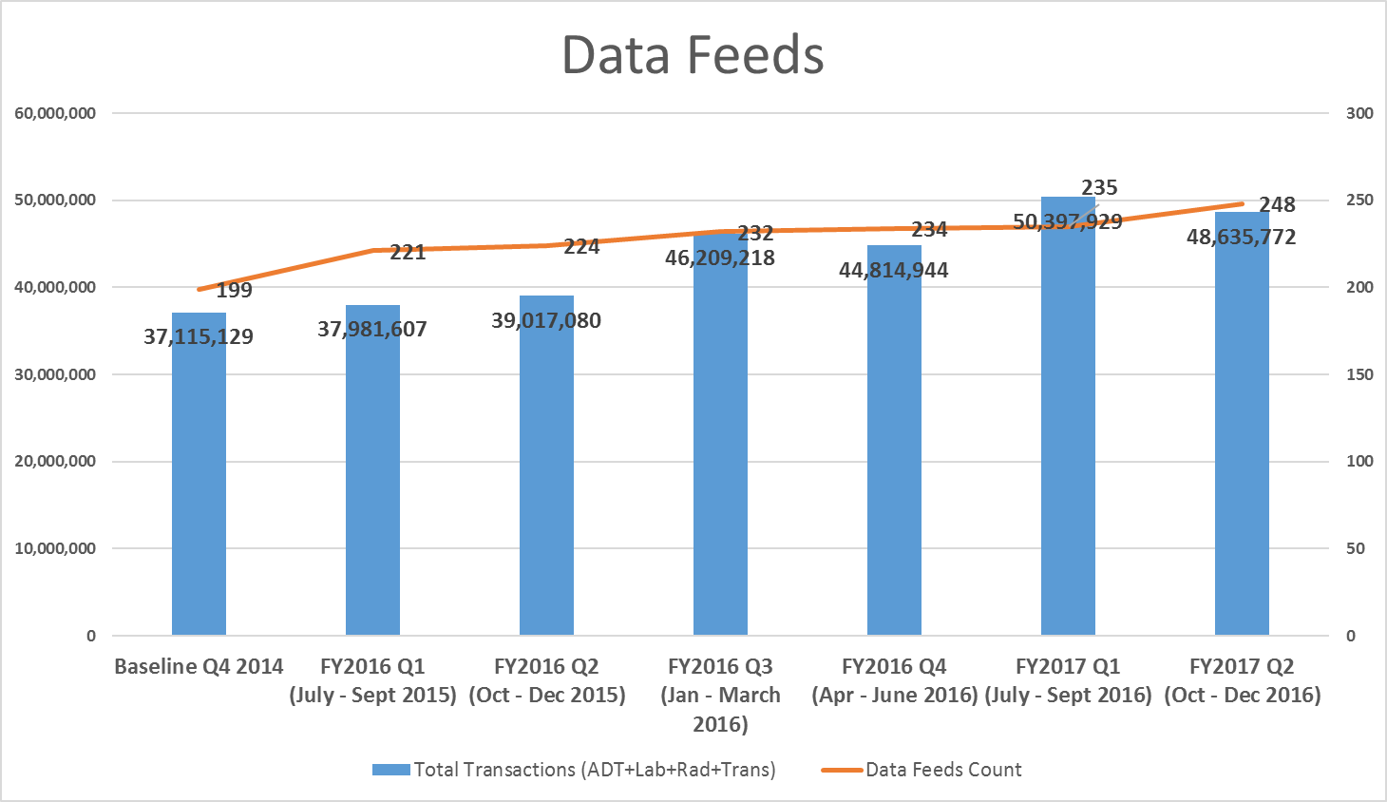
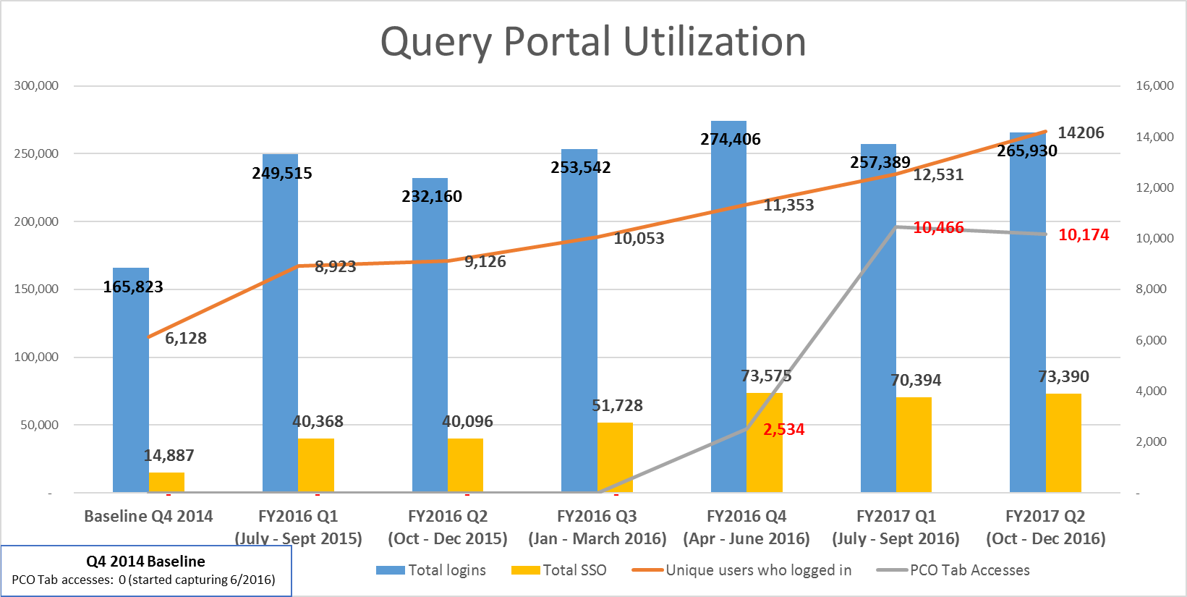
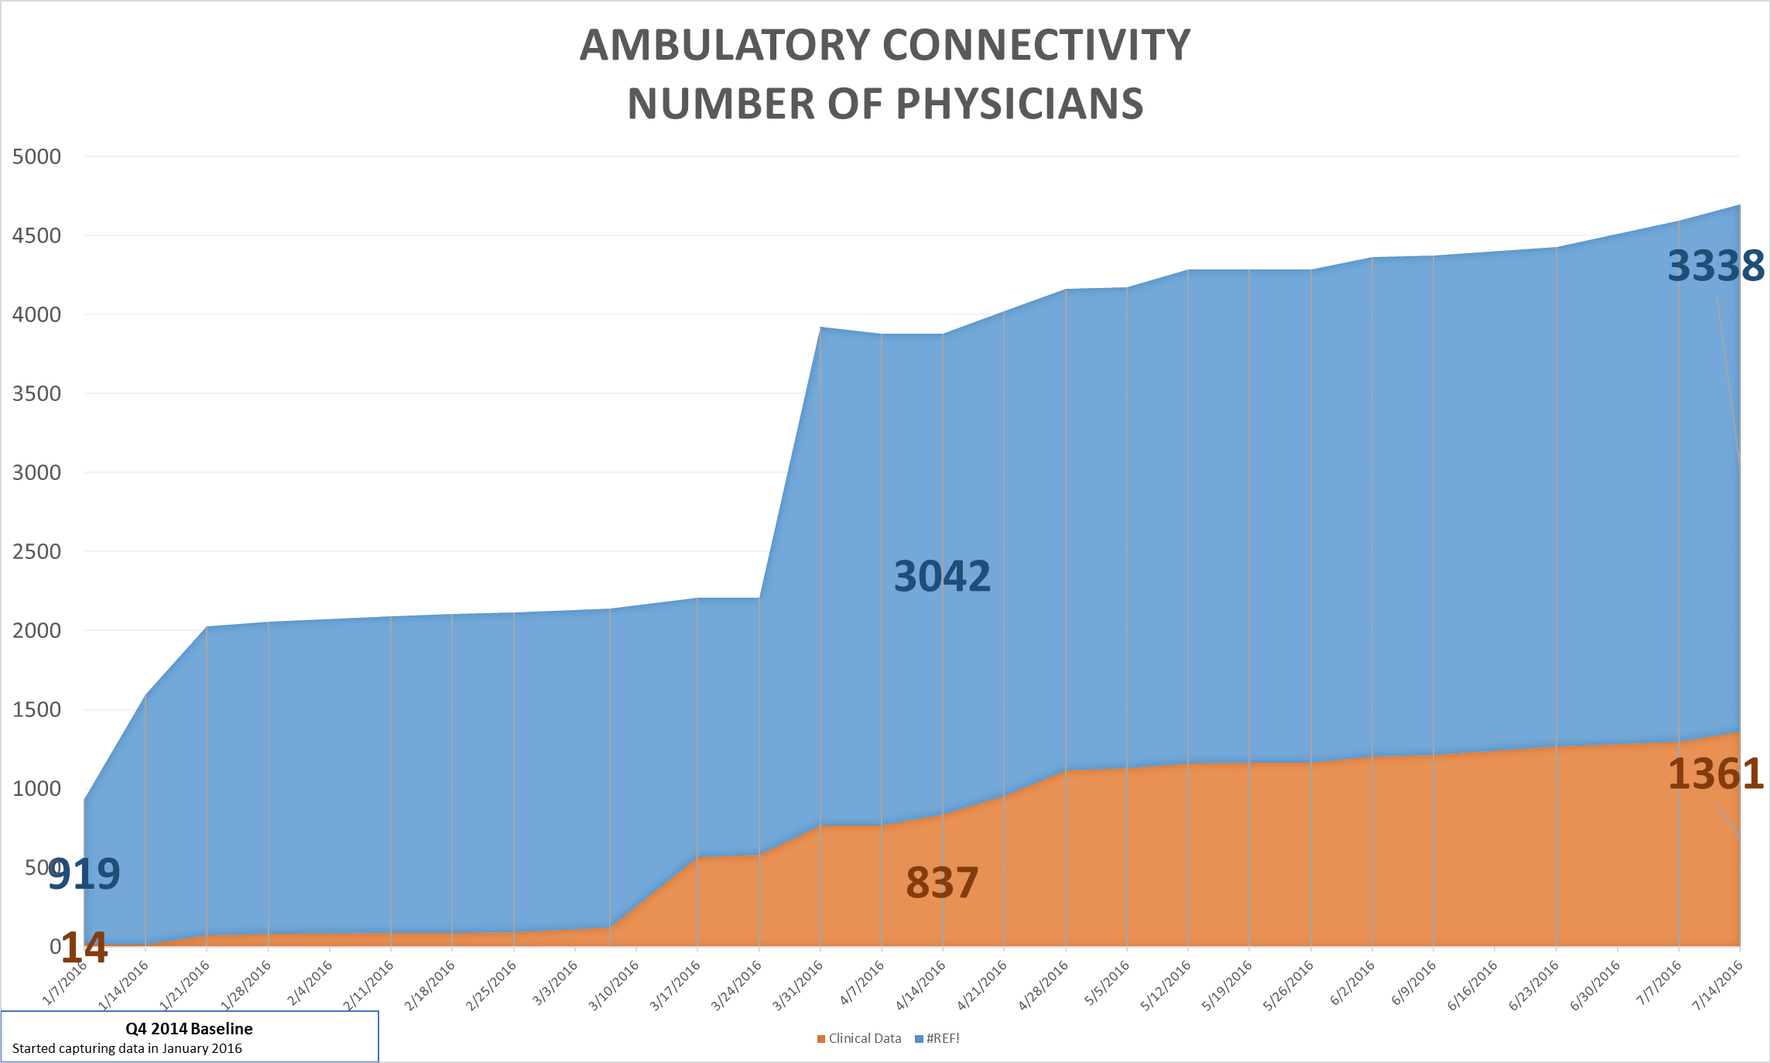
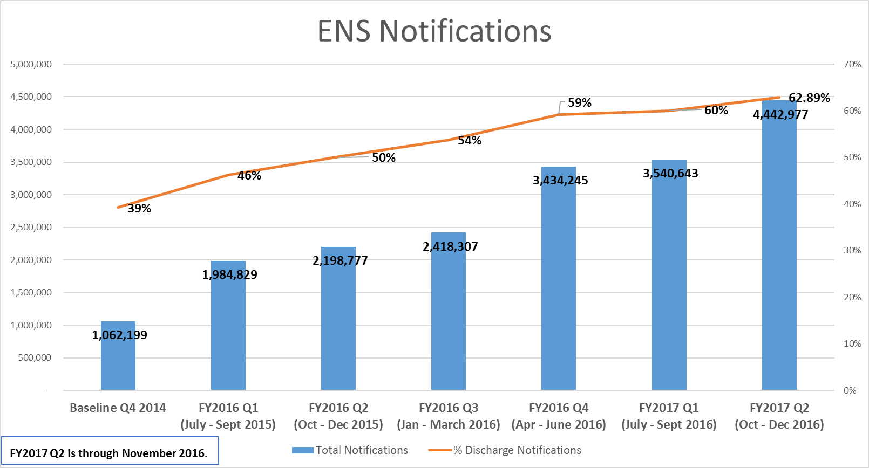
Key Performance Indicator Dashboard

Slide 7

Collaboration with DHMH
Prescription Drug Monitoring Program (PDMP)
PDMP data available to providers and dispensers along side clinical data
Close partnership with Behavioral Health Administration to support the continued development of the program and services
Maryland Mandatory Registration and Use
PDMP data available via In-Context Alerts
Interstate Sharing with West Virginia, Virginia, Connecticut and Arkansas
Population Health Reports
Geographic mapping for public health officials of hospital encounters, and when married to HSCRC claims data, specific conditions
Population health management reports and dashboards at county
and zip-code levels available to Local Health Departments

Slide 8

Collaboration with DHMH
Support of State Medical Examiner and Fatality Review Teams
CRISP serves as a source of clinical information in death investigations
  Overdose Fatality Review
  Maternal Mortality Review
  Fetal & Infant Mortality Review
  Child Fatality Review
Provides administrative efficiencies and data in time-sensitive situations
Meaningful Use
CRISP facilitates public health reporting and attestation for hospitals and providers
  Routing Eligible Hospital data to DHMH
  Providing MU Phone and Email Support to Eligible Professionals
  Working on facilitating case reporting and PDMP as public health reporting options for EP’s
Developed a Registration Tool for tracking MU progress
Developed a validation tool that incorporates HL7 and Maryland message requirements

Slide 9
Collaboration with DHMH
Disease Investigation
Public Health Investigators utilize CRISP for Reportable Disease Investigation
  Demonstrably more efficient and richer data source for hospital-reported conditions than previous methodology
HIV Care Reengagement
  Alert DHMH when HIV positive individuals encounter health system
  Reconnect individuals to treatment and individuals who never learned status
Oz System
Newborn alerting, to facilitate mandatory hearing screening
ImmuNet Registry
DHMH ImmuNet registry data available in CRISP Clinical Query Portal

Slide 10
ICN Program

Slide 11
ICN Background
In 2014, the Maryland Health Services Cost Review Commission (HSCRC), with the support of the Department of Health and Mental Hygiene (DHMH), established a Care Coordination Work Group to offer advice on how hospitals, physicians, and other key stakeholders can work together with government leaders on effective care coordination to support the Maryland All-Payer model.
The workgroup led to the creation of the Integrated Care Network Infrastructure or “ICN” project, through which CRISP was charged to establish processes and leverage services for three components critical to modernization effort:
  Identification of at-risk patients who could benefit from care coordination or a targeted intervention
  Communication—especially at the point of care—of existing patient relationships and connected services
  Monitoring the effectiveness of programs and initiatives, especially by measuring their impacts on the bigger total-cost-of-care

Slide 12
“Workstream” Framework
Anja Hewitt
1. Ambulatory Connectivity: We are connecting more practices, physicians, long-term-care facilities, and other health providers to the CRISP network.
Mike Banfield
2. Routing Data: We are building a data router: including data normalization, patient consent management, patient-provider relationships – for sharing patient-level data.
Ryan Bramble/ Bill Howard
3. Clinical Portal Enhancements: We will enhance the existing Clinical Query Portal with a care profile; a provider directory; information on other known patient-provider relationships; and risk scores.
Jon Becker, PhD
4. Notification & Alerting: We will create new alerting tools so that notifications happen within the context of a provider’s existing workflow. Users are notified when a patient is in care management.
Jerry Reardon, PhD
5. Reporting & Analytics: We will expand existing CRISP reporting services and make them available to a wider audience of care managers. The new services include tools for risk stratification and population health management.
Michelle Rubin
6. Basic Care Management Software: We will support care management software platforms – through data feeds, reports and a basic shared care management tool available to organizations without their own.
David Finney/ Alycia Steinberg
7. Transformation: As the HSCRC Care Coordination Workgroup envisioned, CRISP Will serve as a convener and “general contractor” to support HSCRC’s mandate to implement and administer new transformation programs.

Slide 13
FY17: Focus on Care Coordination
CRISP will support Maryland hospitals this year, with an aim of helping them all do these four things, to collectively improve care coordination:
Flag Patient Care Management Relationships: Notify CRISP for each patient who is enrolled/dis-enrolled in a care management program, including contact information for the patient, care coordinator, and primary care provider.
Share Care Planning Data: Whenever care management information appropriate for sharing is created or updated for a participating patient, send a copy of the information to CRISP.
Use In-Context Alerts: Create an “alert mechanism” in your hospital EHR so your clinicians know when a person who is in care management has shown up, with easy access to the full data.
Use CRISP Reports: Incorporate CRISP reports and compiled data into the work of the population health team. (For patient identification and performance measurement.)
This approach should align with broader interventions and programs in place to support the high need / complex patients

Slide 14
Focus Aligns with State Priority on High and Rising Need Patients
Bringing high need and rising need Medicare patients into care management is key to reducing potentially avoidable utilization (PAU):
High Need: patients with at least 3 inpatient visits* in past 12 months
Rising Need: patients with at least 2 hospital visits in the past 12 months, where a hospital visit is defined as an inpatient OR ED visit
Use in statewide monitoring, assessment of care coordination activities, and CRISP reports
Medicare Fee For Service | High Need | Rising Need
# of Beneficiaries | 20,000 | 95,000
Total Hospital Charges | $1.4 billion | $2 billion
Total Potentially Avoidable Utilization | $550 million | $330 million
% PAU | 40% | 17%
Numbers will change with each monthly data submission and QA
* inpatient visits = inpatient discharges or observation visits > 23 hours

Slide 15
Positive Trends through FY17
Care Coordination Measures – High-needs Medicare FFS Beneficiaries
Measure 1: Known primary care provider or care manager
Beneficiaries | Total | w/PCP |  | w/CM |  | w/both
3/7/2017 | 18,837 | 11,467 | 60.87% | 2,801 | 14.87% | 2,440 | 12.95%
2/10/2017 | 18,856 | 10,967 | 58.16% | 2,594 | 13.76% | 2,258 | 11.97%
1/6/2017 | 18,681 | 10,099 | 54.06% | 1,804 | 9.66% | 1,624 | 8.69%
12/13/2016 | 18,729 | 9,799 | 52.32% | 798 | 4.26% | 653 | 3.49%
12/7/2016 | 18,752 | 9,139 | 48.74% | 463 | 2.47% | 241 | 1.29%
11/29/2016 | 21,509 | 10,427 | 48.48% | 499 | 2.32% | 254 | 1.18%
11/4/2016 | 21,849 | 10,379 | 47.50% | 468 | 2.14% | 239 | 1.09%
9/27/2016 | 21,644 | 9,453 | 43.67% | 172 | 0.79%
Measure 2: Shared care alert or care plan
Beneficiaries | Total | w/CareAlert |  | w/CarePlan |  | w/either
3/7/2017 | 18,837 | 937 | 4.97% | 420 | 2.23% | 1,354 | 7.19%
2/10/2017 | 18,856 | 652 | 3.46% | 360 | 1.91% | 1,011 | 5.36%
1/6/2017 | 18,681 | 536 | 2.87% | 319 | 1.71% | 854 | 4.57%
12/13/2016 | 18,729 | 506 | 2.70% | 276 | 1.47% | 781 | 4.17%
12/7/2016 | 18,752 | 508 | 2.71% | 277 | 1.48% | 784 | 4.18%
11/29/2016 | 21,509 | 410 | 1.91% | 248 | 1.15% | 658 | 3.06%
11/4/2016 | 21,849 | 394 | 1.80% | 231 | 1.06% | 625 | 2.86%
9/27/2016 | 21,644 | 244 | 1.13% | 157 | 0.73% | 401 | 1.85%

Slide 16
What’s Core Moving Forward?
Remainder of FY2017
Four hospital priorities, in particular doing more with care alerts
  Care team/relationships
  Care coordination info
  In-context alerts
  Reporting & analytics
Deriving value from Medicare reports
Ambulatory alignment with Care Redesign programs
  High-priority practices/providers
  Data Exchange Support Program via Medicaid
  LTPAC
What are the priorities for FY2018?
FY2018
Moving down the risk pyramid with the four hospital priorities
Pivot towards measuring utilization of the data, not just more data
Care management information being delivered from new payers
Tier four ambulatory connectivity
Supporting Care Redesign and the waiver progression plan
LTPAC

Slide 17
Data Exchange Support Program
Purpose: To support CRISP’s mission, improving care coordination in Maryland communities and the region
Details:
Federal funding (IAPD) coupled with state funding (ICN) will accelerate current health information exchange adoption and connectivity work by providing financial support directly to the practices for providing data to CRISP
Designed to align with Care Redesign/CCIP program and Maryland Comprehensive Primary Care model
Aligns with national Medicare priorities such as CCM and MIPS
Goal: Establish 200 ambulatory practice connections, 25 behavioral health facility connections and 65 skilled nursing facility connections in a 12 month period.
Notes:
EXTERNAL – CMS Funding Sponsors & DHMH

Slide 18
Who is eligible for the financial support?
Medicaid Eligible Providers (EPs), OR
Non Eligible Medicaid practices with at least one patient overlap with an EP (NEMPs), OR
Medicare providers
Note: the practice’s certified EHR must be capable of providing required data elements in order for the practice to take advantage of the full financial opportunity. This requirement aligns with MACRA.
Notes:
EXTERNAL – CMS Funding Sponsors & DHMH

Slide 19
Data Exchange Support Program Summary
Ambulatory Practice & Behavioral Health
Requirement/Opportunity | Payment Schedule
Milestone 1: Initiation * Complete CRISP Participation documentation * Sign interface agreement with EHR vendor to integrate with CRISP | $3,000
Milestone 2: Go-Live with 1 AND (2b OR 2b): Encounter data interface (ADT, SIU, etc.): $2,000 C-CDA interface that meets one of the two options below (1) Interface meets Meaningful Use Summary of Care C-CDA core elements: $5,000 (2) Interface meets at least 12 Meaningful Use clinical quality measures: $8,000 | $7,000 - A & B(1) OR $10,000 - A & B(2)
Additionally, receive $500 for each provider per practice upon completion of the C-CDA interface. This will be paid out with Milestone 2. The payment will be specific to the interface setup. Therefore, if a multi-practice site sets up a single interface that includes 10 practices, a single milestone payment will be made, but the per-provider payment will still take effect. This amount will also be capped at payment for a maximum of 40 providers. | $500/Provider
Notes:
INTERNAL to CRISP – General program education

Slide 20
Data Exchange Support Program Summary
Post Acute Care Facilities
Requirement/Opportunity | Payment Schedule
Milestone 1: Initiation * Complete CRISP Participation documentation * Sign interface agreement with EHR vendor to integrate with CRISP | $3,000
Milestone 2: Go-Live with: * Encounter data interface (ADT, SIU, etc.): $4,000 * C-CDA interface: $5,500 o Must contain: demographics, encounters, labs, allergies, medications, procedure, and diagnoses | $9,500
Total Potential Payment per Facility | $12,500
Notes:
INTERNAL to CRISP – General program education

