Slide 1
Driving 7 Elements of Success for Case Management
Presented by Cheri Lattimer, RN, BSN
Executive Director – National Transitions of Care Coalition (NTOCC)

Slide 2
Continuum of Care & Spectrum of Services
How will you coordinate care beyond your service?
Home Health
Skilled & LTC
Community
Based Services
Health & Wellness
Enrollment
Acute Hospitalization
Specialist
Palliative Care
Sub-acute
Rehab
Health
Health
Respite Care
Doctor's
Office
Hospice
OP Therapies
Long Term
Acute
Hospital
Diagnostic
& Treatment
Center
Case/Disease
Management

Slide 3

It is Complicated but Only Working Together as a Collaborative Team Addressing the Care Needs of the Patient & Family Caregiver Can Improve This Process
PCP/Medical Home
Home Health
LTC
Adherence
Advocate
Motivational
Interventions
Community Health
Center
Assessment & Support
Non-Adherence
Behavior Health Change
Coordination & Care Plan
Medication Reconciliation
Facilitation
Assessment
Care Plan
Hospital
Motivational Advocacy
Patient &
Caregiver
Facilitation
Health
Promotion
Adherence
Health Plan
Assessment & Support
Assessment & Support
Specialist
Prescription
Increase
Productivity
Assessment & Care Plan
Pharmacy
Hospice
Area Agencies on Aging
Employer

Slide 4



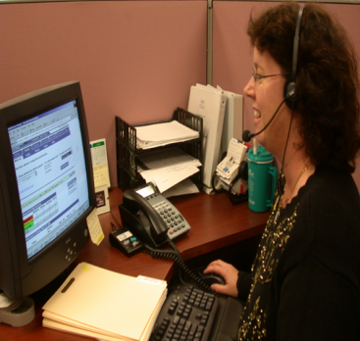

The Collaborative Interprofessional Care
Team
Patient
Family Caregiver
Physicians
Wellness or Health Coaches
Lab and Radiology Professionals
Allied Health Professionals
Front Office Staff
Case Managers
Medical Assistant
Pharmacist
Specialists
Hospitalist
Nurses
Therapists
Social Workers
Paraprofessional

Slide 5

Case Managers Are Positioned to Take a Center Role in The Collaborative Care Team
Knowledge and experience with care coordination
Focus on patient-centered processes and shared-decision making
Assessment, planning, facilitation across care continuum
Knowledge of population-based care management strategies
Meaningful communication with patient, family, care team – addressing health literacy
www.cmsa.org – CMSA Standards of Practice 2016

Slide 6
NTOCC’s Seven Essential Interventions Categories
1
Medications Management
2
Transition Planning
3
Patient and Family Engagement / Education
4
Health Care Providers Engagement
5
Follow-Up Care
6
Information Transfer
7
Shared Accountability across Providers and Organizations
http://www.ntocc.org/Toolbox/browse/

Slide 7
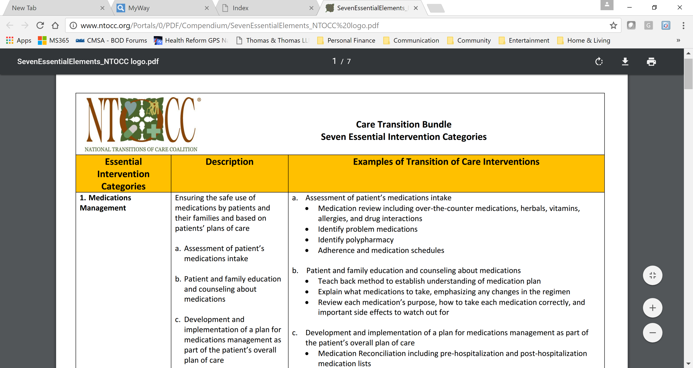
NTOCC Care Transition Bundle – 7 Essentials Interventions Categories – www.ntocc.org

Slide 8
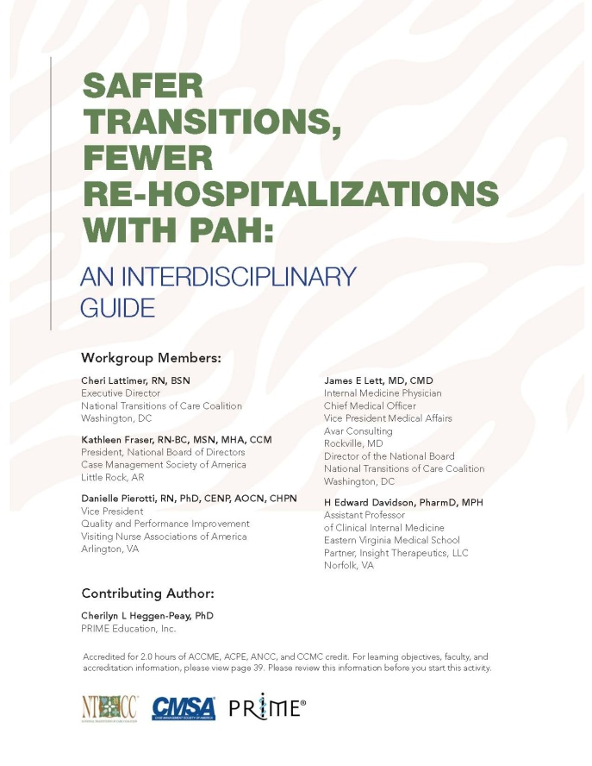
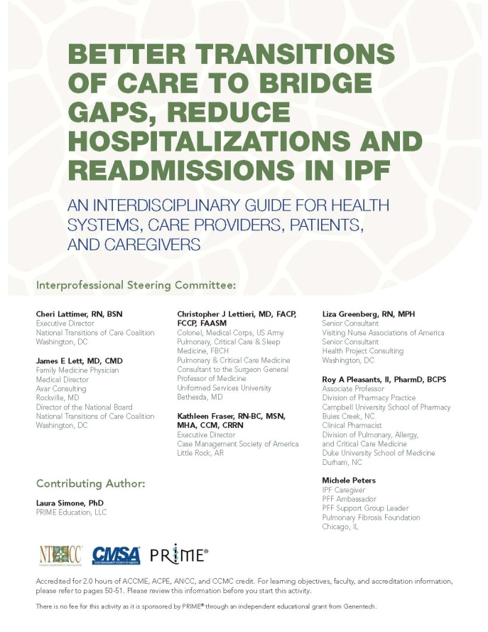
Transitions of Care Pathways for Rare Respiratory Diseases
  2 CE-accredited papers released in 2016, focusing on transitions of care for patients with pulmonary arterial hypertension (PAH) and idiopathic pulmonary fibrosis (PAH)
  Developed in partnership with:
    Case Management Society of America
    National Transitions of Care Coalition
    PRIME Education, LLC
  Provide disease-specific tools and resources for the interdisciplinary team
  Available at primeinc.org
CE = continuing education.
Notes:
Begin with a brief overview of both papers. Conclude the slide by stating that today’s webinar will focus on PAH (red circle appears upon clicking mouse).

Slide 9
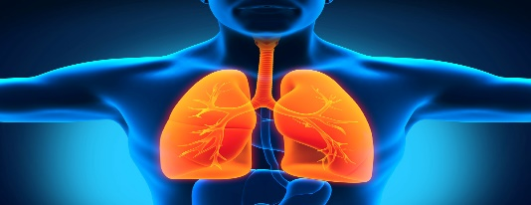
Pulmonary Arterial Hypertension (PAH)
Pulmonary arterial hypertension (PAH) is a type of pulmonary hypertension (PH), an uncommon condition associated with elevated pressure w/in the pulmonary arteries
Untreated, usually results in right sided heart failure & death.
  Symptomatology is generally non-descript and may include dyspnea, fatigue, weakness, chest pain, syncope, abdominal distention, and/or ankle swelling
Prevalence of PAH in the US estimated at 12.4 cases/million. Frost AE, Badesch DB, Barst RJ, et al. The changing picture of patients with PAH in the US: how REVEAL differs from historic and non-US Contemporary Registries. Chest. 2011;139(1):128-137.
Despite its relative rarity, has considerable impact with high rates of morbidity, hospitalization, and mortality. In addition, healthcare costs and resource utilization for PAH patients are significant. Sikirica M, Iorga SR, Bancroft T, et al. The economic burden of PAH in the US on payers and patients. BMC Health Serv Res. 2014;14:676.
It is commonly assessed using the World Health Organization (WHO) functional classification which lists four categories:
  From Class I (no limitations in physical activity) to Class IV (patients with severe limitations in physical activity)

Slide 10

PAH: Barriers & Gaps for Care
PAH is relatively rare and its symptoms nonspecific, thus often under-recognized & diagnosis delayed
Recent report reveals the mean length of time from onset of symptoms to diagnosis was 2.8 years. Badesch DB, Raskob GE, Elliott CG, et al. PAH: baseline characteristics from the REVEAL Registry. Chest. 2010;137(2):376-387.
  See multiple providers as they navigate a long path to diagnosis
Thus, patients often in advanced stages of disease (WHO functional class III or IV) by the time they are diagnosed, missing opportunities for early intervention. Thenappan T, Shah SJ, Rich S, et al. A USA-based registry for PAH: 1982-2006. Eur Respir J. 2007;30(6):1103-1110.
Even once diagnosed, patients may not receive evidence-based therapy. One study found that 57% of the prescribed medications for patients on PAH-specific therapies were not consistent with published guideline recommendations upon referral to a PH specialist. Deano RC, Glassner-Kolmin C, Rubenfire M, et al. Referral of patients with pulmonary hypertension diagnoses to tertiary pulmonary hypertension centers: the multicenter RePHerral study. JAMA Intern Med. 2013;173(10):887-893.

Slide 11

PAH: Barriers to Effective Care Transitions
Delivery System-Level Barriers
  Care settings functioning as “silos”
  Non-operability of EMRs
  Misaligned incentives to coordinate care
  Differing formularies change meds & confuse the patient
  Insurance coverage forces changes in meds, providers, care setting & LOS
Clinician-Level Barriers
  Multiple clinicians: PCP, PAH & other specialists, hospitalist, SNFist, etc
  Competing plans of care w/duplication of testing & unnecessary med changes
  Multiple care managers “reinventing the wheel”
  Lack of awareness & experience with PAH
Patient-Level Barriers
  Unfounded assumptions of communication among the clinical team
  Lack of understanding of the dz process & care needs
  Lack of empowerment to question &/or engage in decision-making
  Insufficient info in a fashion they understand
  Complexity of PAH care & process is overwhelming for patients & caregivers
  Conflicting information from different care sites & clinicians

Slide 12
The Interprofessional PAH Care Team
Primary Care Team
Community Pulmonologist
PAH Care Center
Hospital Care Team
Case Managers, Nurses, Allied Health Professionals
Pharmacists
Post-Acute Care Team
PAH Patient and Family/Caregiver
  Team members must know, understand, and commit to their roles
  Identify specific care transition responsibilities for each individual and discipline
  Provide training and education on management of care transitions and information transfer

Slide 13
Medication Management
Assessment of patient medication intake
  Medication review including over the counter medications, herbals, vitamins, allergies and drug interactions
  Identification medication-related problems
Patient and family education and counseling about medications
  Teach-back method to establish understanding of the medication plan
  Explain what medication to take, discussion of changes in the regime and rationale for changes
  Review each medication purpose and how to take or administer each medication correctly
Development and implementation of a plan for medication management as part of the patient’s overall plan of care
  Provide medication reconciliation and a patient medication list
  Communicate and distribute medication reconciliation lists to all care team sites
  Communication between PAH specialty care center and community care providers

Slide 14
Transition Planning
Due to the incurable progressive nature of PAH, patient undergo multiple care transitions
Clearly identify the interdisciplinary care team members and coordinate the patient’s transition plan
Management of the PAH patient’s and family’s/caregiver’s transition needs
Use formal transition planning tools (providers, patients and families/caregivers)
Timely and complete transition summary

Slide 15
Importance of Patient Engagement to Support Safe Care Transitions
Patients need education and support to navigate transitions, including transition to self-care at home after diagnosis, hospitalization, or change in therapy
  Strategies to facilitate patient engagement include:
    Promoting shared decision-making
    Educating patients and families/caregivers on disease management
    Implementing system-wide programs:
      24/7 visitation policies for families
      Rounding and nurse shift reports at patient’s bedside
      Patient-centered discharge planning
      Patient-accessible EHRs
      Patient involvement on quality improvement, patient care, and safety committees
The Joint Commission. Transitions of Care: Engaging patients and families. http://www.jointcommission.org/assets/1/23/Quick_Safety_Issue_18_November_20151.PDF. Accessed 1/3/2017.

Slide 16
Health Literacy
  Health literacy problems are widespread
    Only 12% of English-speaking adults demonstrate proficiency in health literacy and numeracy
  Low health literacy is a predictor of 30-day hospital readmissions
  Resources and strategies that promote clear communication between providers and patients are essential to addressing health literacy barriers
    National Patient Safety Foundation’s “Ask Me 3” program
What is my
main problem?
What do I
need to do?
Why is it important for me to do this?
National Patient Safety Foundation. www.npsf.org. Accessed 1/3/2017;
Mitchell SE, et al. J Health Comm. 2012;17(Suppl 3):325-338.

Slide 17
Patient and Family/Caregiver Education and Engagement
Ensure patients and families/caregivers are knowledge about PAH and have a plan of care they can understand and implement:
  Assess health literacy and gaps in the patient’s and family’s/caregiver’s knowledge
  Assess clinical and non-clinical issues
  Patient/caregiver understanding of “red flags” for PAH symptom escalation and who to contact for support
Patient and family-centered transition communication
  Multidisciplinary approach to ensure that the care team, patient and family are speaking the same language/information
Development of self-management skills
  Assess the patient’s and family’s/caregivers ability to manage their manage their medication therapies, including infusion and oxygen
  Tools and resources for self-management & care team engagement

Slide 18
Healthcare Provider Engagement
Clearly identified patient’s primary care team
  Personal physician
  Enhanced access to services
  Refer patients to expert PAH care centers
  Communication, communication, communication
Clearly identified patient’s PAH expert care center team
Clearly identified patient’s hospital and care continuum team
Use of recognized PAH practice guidelines (evidence-based guidelines)
Hub of case management activities
  Improve documentation around change in patient’s condition
  Improve the flow of information between the care team and all levels of care
  Take the role of communication hub
  Medication reconciliation during transitions of care

Slide 19
Role of the Professional Case Manager
A complete assessment of Medical, Behavioral, Social and Health system issues and concerns
Patient and family advocacy identifying and supporting patient preference
Defining and improving educational & knowledge deficits
Development of a plan of care that supports the patient and family in working with their care team
Collaboration with the pharmacist in developing the patients medication lists and understanding the medication regime
Assisting the patient and family in recognizing “red flags” for PAH symptom escalation
Enhancing care coordination and access to care options
Communication, motivational support, health coaching and clarification of miscommunication
Advanced care planning

Slide 20
Follow Up and Information Transfer
PAH patients and families require timely key access to key healthcare providers after an episode of care as required by the patient’s condition and needs
  Transitional care follow up with care team members, physician, nurses, case managers, social work, home health
  Review with patient and family the follow-up care plan
Communication with patients and/or families and other health care providers post-transition from an episode of care:
  Call to patient 24-48 hours after transition
  Home visit
  Reasseement of care plan and regular contact times with patient and family
Implementation of clearly defined communication models
Use of formal communication tools
Clearly defined providers, care centers, and community resources to facilitate timely transfer of critical information

Slide 21
Patient and Family-Centered Transition Communication
PAH Patient, Family, Caregivers
Use a multidisciplinary approach to ensure that the care team, patient, and family/caregiver are speaking the same language/information
Health literacy cannot be stressed enough!
Support dialogue on advance care planning and the needs of the patient and family
Provide real-time, face-to-face discussions with patients and families/caregivers to eliminate miscommunication

Slide 22




Develop Self-Care Management Skills
Assess patient’s and family’s/caregiver’s ability to manage their medication therapies, including oxygen, and develop the care plan around that assessment
Provide opportunity for appropriate patient teach-back and discussion of risk issues
Develop a nutrition plan with the patient and family/caregiver assessing concerns related to cultural, financial, and social burden
Goal of asking and supporting patients and families/caregivers to take responsibility for monitoring their own healthcare needs on a daily basis, maintaining an up-to-date medication list, and how and when to seek appropriate assistance when needed

Slide 23

PAH: Summary
Despite significant therapeutic advances PAH remains a progressive, incurable disease
Patients undergo multiple transitions throughout the course of their disease & care settings must anticipate & plan for these
PAH is relatively rare &management is complex, thus essential to
  Follow evidence-based guidelines, &
  Consider referral to an expert PH care center whenever possible
Transitions to the patient’s home, SNF, or palliative care/hospice have special considerations.
  Providers must ensure that patients & families/caregivers understand & are equipped to carry out the care plan at home, including management of complex PAH therapies
  SNF, palliative care & hospice must be able to provide PAH care

Slide 24
PAH: Summary
At transition points, timely, bi-directional communication & individualized information transfer, along with follow up, is essential
Following care transitions, healthcare providers should follow-up promptly to verify successful transition.
Advance planning discussions should be conducted early with PAH patients & their families/caregivers to identify a medical power of attorney & document patient wishes regarding end-of-life care
Care settings should establish quality measures and assess management of care transitions on an ongoing basis.

Slide 25
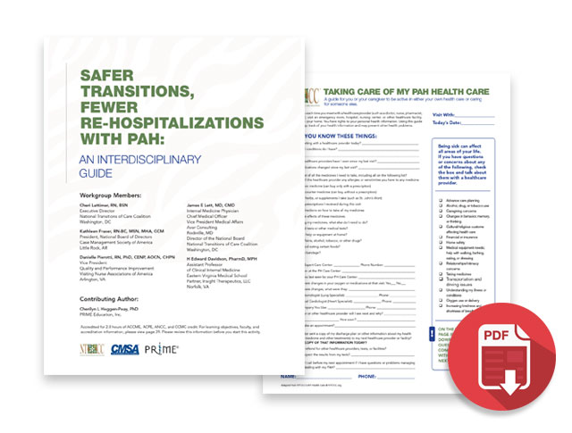
Available at: www.primeinc.org/pah
Accredited for 2.0 hours of ACCME, ACPE, ANCC, and CCMC credits

Slide 26
Questions

